Slide 1
Analysis of Customer Buying Behaviour
British Airways

Slide 2
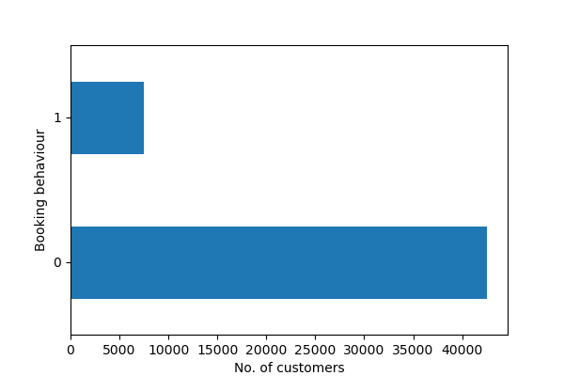
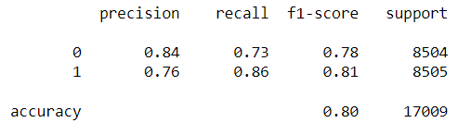
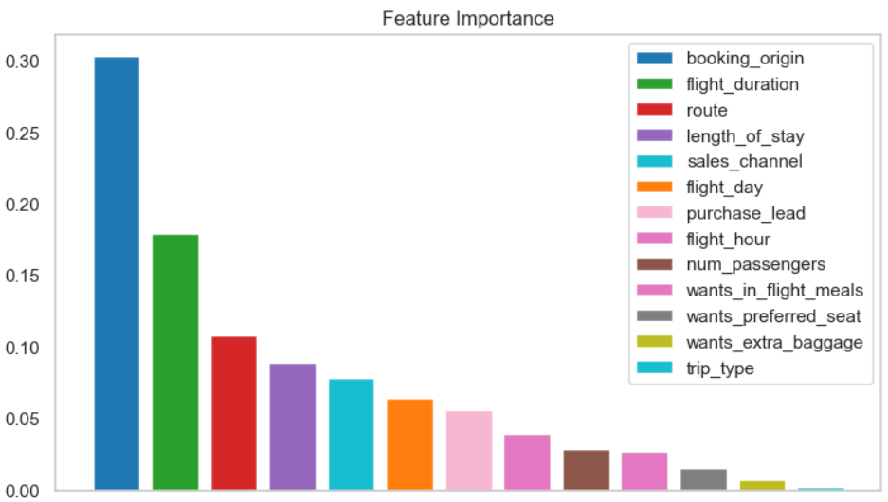
RESULTS
Dataset Composition
Only 15% of the customers completed the booking, while 85% did not complete the booking.
The dataset was highly imbalanced, to address which SMOTE (Synthetic Minority Over-sampling Technique) was used for building the model.
Results of Classifier model
The model was trained on 80% of the data and tested on 20% of the data.
The model achieved an accuracy of 80% on the test data.
Classification report for model evaluation:
Importance of different variables in predicting customer buying behaviour is shown in the graph:

